Slide 1

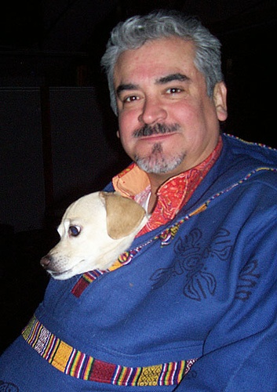
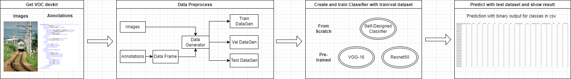
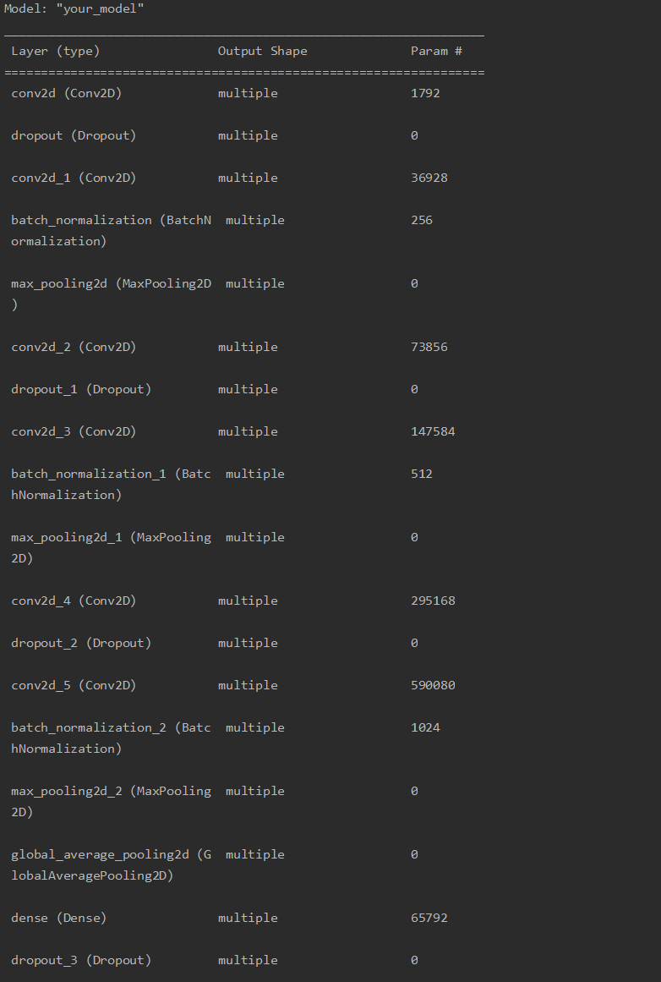
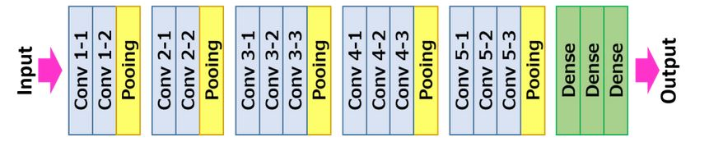
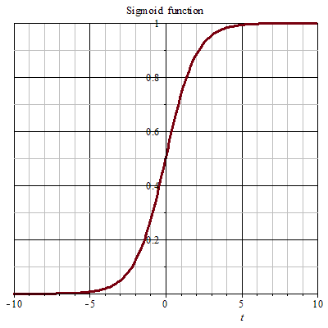
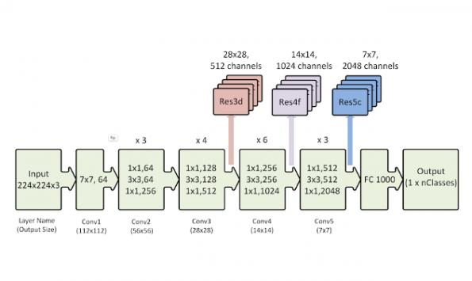
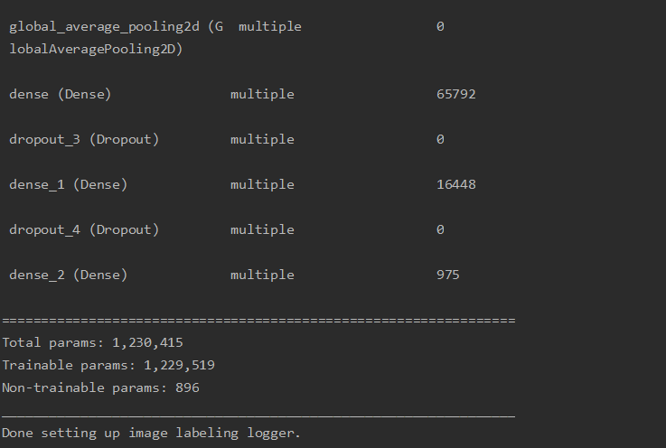
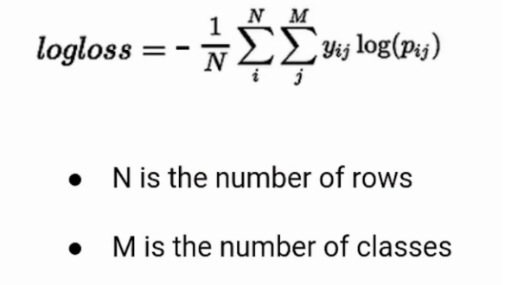
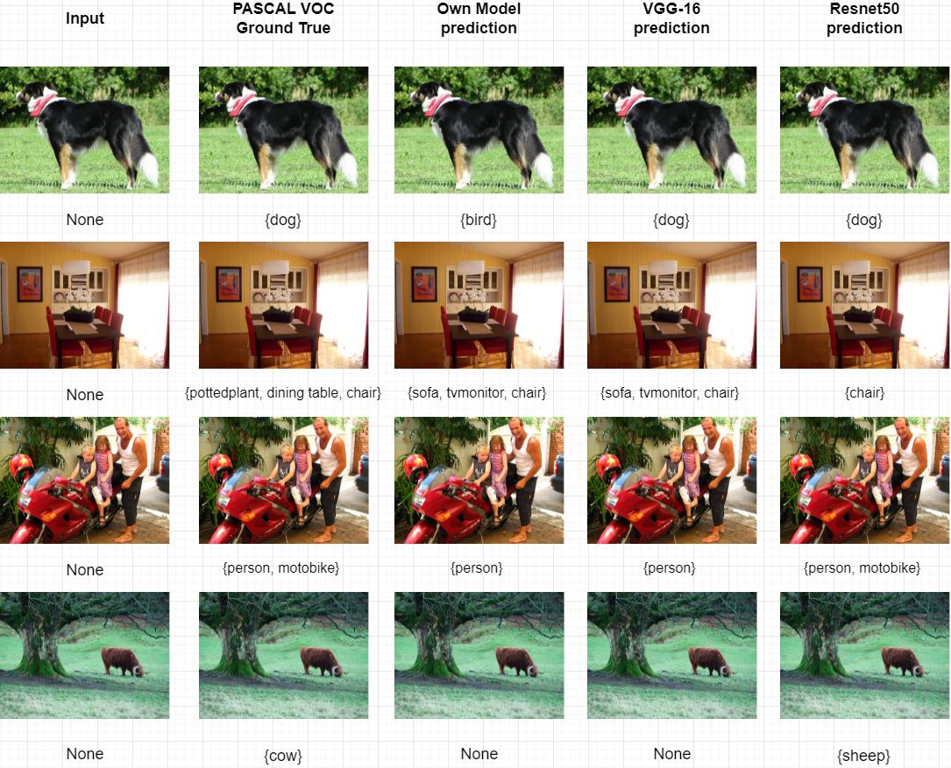
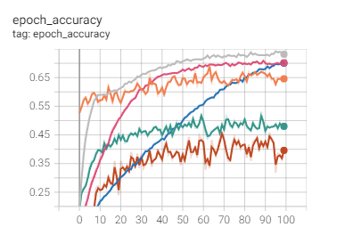
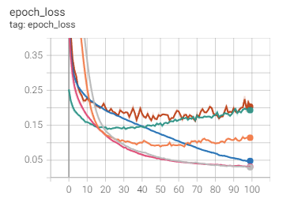
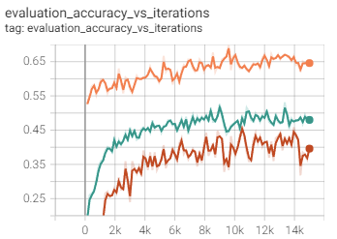
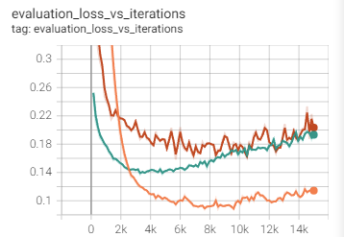
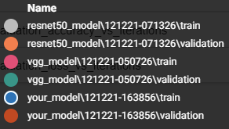
Multi-label Classification on PASCAL VOC 2007 Dataset
Changcheng Fu
Motivation
Define the problem
Goal
Nowadays, machine learning becomes a good technique for us to solve more social issues in a wiser way. While involving in large-scale data, such as music, news, and pictures, it’s helpful for people to gain an efficient method to create labels for those large data in order to classify their features.
Multi-label classification involves predicting zero or more class labels. Unlike traditional classification tasks where class labels are mutually exclusive, multi-label classification requires specialized machine learning algorithms that support predicting multiple mutually non-exclusive classes or “labels.”
As a result, it raise my attention on design pipeline for solving multi-label classification tasks with large dataset.
Data processing
Utilize the PASCAL VOC 2007 and convert the dataset for specific multi-label classification task
Link Images with Annotations and Classes file in order to make useful inputs as data generator so that our model can learn with logic.
Split input data as train/val to prevent overfitting.
Classification
Classify and predict labels for images.
Can be consistently defined for each categories and output multiple features for images if possible.
State Goals
Able to output prediction for each categories for each images
Improve model with transfer-learning and modern architecture to increase accuracy.
Dog, Person
Project Overview and Solution
Model Architecture and loss function
My own CNN classifier
VGG-16 Classifier
Activation Func: Sigmoid
Resnet50 Classifier
We create a pipeline to solve the multi-label Classification problem by several steps:
We download official open resource VOC devkit from website and separate it out as Images(.jpg), Classes(.txt) and Annotations(.xml)
By using classes and annotations, we can link the specific class for each image filename in order to create data frame for each images and then create data generator by linking image path with preprocessed data frame.
We implement and compile three different types of model(one from scratch, two loading from pre-trained weights and trained the last convolutional layer along with fully connected layers after) using Keras, and then fit models with our data generators. After 100 epochs finding the best weights by evaluation, we use the checkpoint with highest accuracy to predict the test generator and output the value to csv for visualization.
Finally, we link the csv file with image by using the filename to perform multi-label classification to images. In addition, we compare the output with ground truth label from generator with the output from csv file to see whether our prediction is correct visually.
Loss Func: Binary Cross-Entropy
Results with Accuracy
Training Details and Prediction Outcome
1. Here are results for prediction labels via differ-
ent models.
2. Graphs for details during training and evaluation.
After finishing the training process and applied your model to the validation dataset for evaluation.
Our own model reach the accuracy of 46.35% at epoch 69. After that, the pre-trained VGG-16 model with our fine-tuned last convolution layer along with dense layers reach the accuracy of 53.12% at 88 epoch. Finally, the ResNet50 reach the highest accuracy of 69.79% at epoch 63.
References
Acknowledgements
[1] Karen Simonyan and Andrew Zisserman. Very deep convolutional networks for large-scale image recognition, CPVR 2015. arXiv:1409.1556
[2] Kaiming He, Xiangyu Zhang, Shaoqing Ren, and Jian Sun. Deep residual learning for image recognition, CPVR 2015. arXiv:1512.03385
[3] Tsoumakas, Grigorios & Katakis, Ioannis. (2009). Multi-Label Classification: An Overview. International Journal of Data Warehousing and Mining. 3. 1-13. 10.4018/jdwm.2007070101.
We would like to thank some open resource and tutorials for inspirations.
https://github.com/thatbrguy/Multilabel-Classification
https://vijayabhaskar96.medium.com/tutorial-on-keras-flow-from-dataframe-1fd4493d237c
https://github.com/Kenneth-ca/holbertonschool-machine_learning/tree/master/supervised_learning/0x09-transfer_learning

